Slide 1
Queues
© 2013 Goodrich, Tamassia, Goldwasser
Queues
Notes:
Queues

Slide 2
The Queue ADT
The Queue ADT stores arbitrary objects
Insertions and deletions follow the first-in first-out scheme
Insertions are at the rear of the queue and removals are at the front of the queue
Main queue operations:
  enqueue(object): inserts an element at the end of the queue
  object dequeue(): removes and returns the element at the front of the queue
Auxiliary queue operations:
  object first(): returns the element at the front without removing it
  integer len(): returns the number of elements stored
  boolean is_empty(): indicates whether no elements are stored
Exceptions
  Attempting the execution of dequeue or front on an empty queue throws an EmptyQueueException
© 2013 Goodrich, Tamassia, Goldwasser
Queues
Notes:
Queues

Slide 3

Queues
First In First Out (FIFO)
  Remove the least recently added item
  A queue has a front and a rear
  Analogy: waiting lines at the supermarket

Slide 4
Queue in Action
Visualization time
  http://www.cs.usfca.edu/~galles/visualization/QueueArray.html

Slide 5
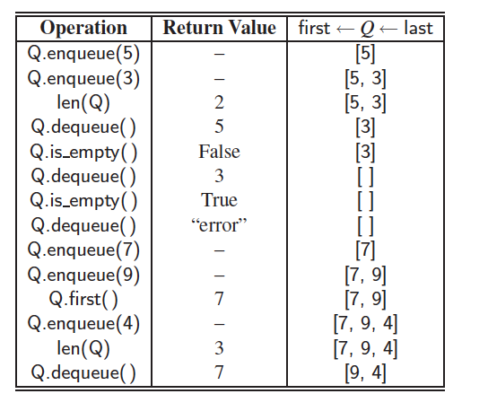
Example
© 2013 Goodrich, Tamassia, Goldwasser
Queues

Slide 6
Applications of Queues
Direct applications
  Waiting lists, bureaucracy
  Access to shared resources (e.g., printer)
  Multiprogramming
Indirect applications
  Auxiliary data structure for algorithms
  Component of other data structures
© 2013 Goodrich, Tamassia, Goldwasser
Queues

Slide 7
Let’s implement a queue (FIFO)
Define a Queue class having following methods:
  __init__(self): #Initialize a queue
  __len__(self): #Return length of queue
  is_empty(self): #Return True if queue is empty
  enqueue(self,e): #Enqueue element e in the queue.
  dequeue(self): return an element from the queue and delete that element.
  front(self): returns the element at the front without removing it
© 2013 Goodrich, Tamassia, Goldwasser
Queues

Slide 8
Array-based Queue
Use an array of size N in a circular fashion
Two variables keep track of the front and rear
  f index of the front element
  r index immediately past the rear element
Array location r is kept empty
normal configuration
Q
0
1
2
f
r
wrapped-around configuration
Q
0
1
2
r
f
© 2013 Goodrich, Tamassia, Goldwasser
Queues

Slide 9
Queue Operations
We use the modulo operator (remainder of division)
Algorithm size()
return (N − f + r) mod N
Algorithm isEmpty()
return (f = r)
Q
0
1
2
f
r
Q
0
1
2
r
f
© 2013 Goodrich, Tamassia, Goldwasser
Queues

Slide 10
Queue Operations (cont.)
Operation enqueue throws an exception if the array is full
This exception is implementation-dependent
Algorithm enqueue(o)
if size() = N − 1 then
throw FullQueueException
else
Q[r] ← o
r ← (r + 1) mod N
Q
0
1
2
f
r
Q
0
1
2
r
f
© 2013 Goodrich, Tamassia, Goldwasser
Queues

Slide 11
Queue Operations (cont.)
Operation dequeue throws an exception if the queue is empty
This exception is specified in the queue ADT
Algorithm dequeue()
if isEmpty() then
throw EmptyQueueException
else
o ← Q[f]
f ← (f + 1) mod N
return o
Q
0
1
2
f
r
Q
0
1
2
r
f
© 2013 Goodrich, Tamassia, Goldwasser
Queues

Slide 12
Queue in Python
Use the following three instance variables:
  _data: is a reference to a list instance with a fixed capacity.
  _size: is an integer representing the current number of elements stored in the queue (as opposed to the length of the data list).
  _front: is an integer that represents the index within data of the first element of the queue (assuming the queue is not empty).
© 2013 Goodrich, Tamassia, Goldwasser
Queues

Slide 13
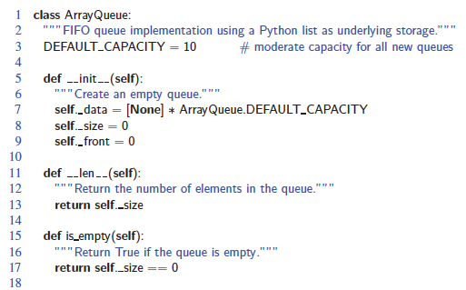
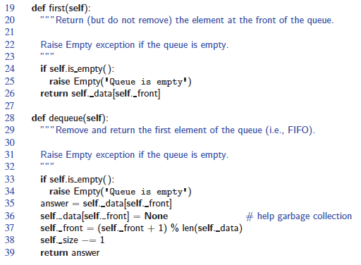
Queue in Python, Beginning
© 2013 Goodrich, Tamassia, Goldwasser
Queues

Slide 14
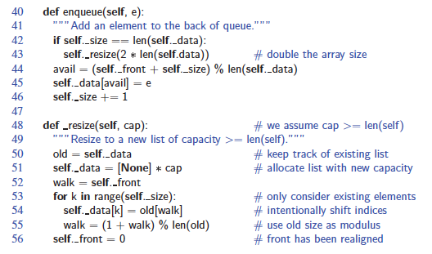
Queue in Python, Continued
© 2013 Goodrich, Tamassia, Goldwasser
Queues
Notes:
Queues

Slide 15
Adding and Removing Elements
(Queue in Python, continued)
In enqueuer(self, e):
  avail = (self._front + self._size) % len(self._data)
  self._data[avail] = e
  self._size += 1
In dequeuer(self)
  answer = self._data[self._front]
  self._data[self._front] = None
  self._front = (self._front + 1) % len(self._data)
  self._size −= 1
  return answer
© 2013 Goodrich, Tamassia, Goldwasser
Queues
Notes:
Queues

Slide 16
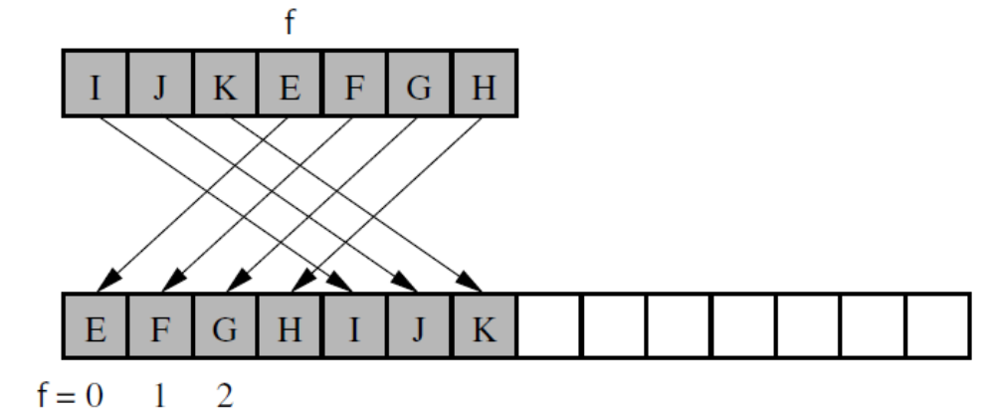
Resizing the Queue
(Queue in Python, continued)
© 2013 Goodrich, Tamassia, Goldwasser
Queues

Slide 17
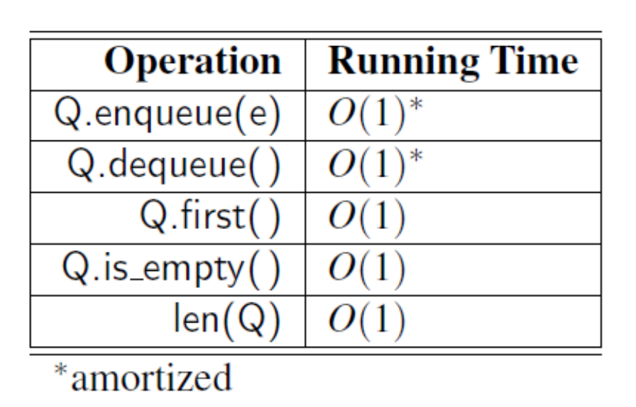
Analyzing the Array-Based Queue
© 2013 Goodrich, Tamassia, Goldwasser
Stacks
Notes:
Performance of our array-based stack implementation. The bounds for
push and pop are amortized due to similar bounds for the list class. The space
usage is O(n), where n is the current number of elements in the stack.

Slide 18
Double Ended Queue (Deck) ADT
D.add first(e): Add element e to the front of deque D.
D.add last(e): Add element e to the back of deque D.
D.delete first( ): Remove and return the first element from deque D; an error occurs if the deque is empty.
D.delete last( ): Remove and return the last element from deque D; an error occurs if the deque is empty.
D.first(): Return (but do not remove) the first element of deque D;
an error occurs if the deque is empty.
D.last(): Return (but do not remove) the last element of deque D;
an error occurs if the deque is empty.
D.is empty( ): Return True if deque D does not contain any elements.
len(D): Return the number of elements in deque D;
© 2013 Goodrich, Tamassia, Goldwasser
Queues

Slide 19
Application: Round Robin Schedulers
We can implement a round robin scheduler using a queue Q by repeatedly performing the following steps:
  e = Q.dequeue()
  Service element e
  Q.enqueue(e)
Queue
Dequeue
Enqueue
Shared
Service
© 2013 Goodrich, Tamassia, Goldwasser
Queues

